Slide 1
DATAVIZ 300 Week 4: Designing Impactful Visualizations Asking Harder Questions of your Data

Slide 2
Course Topics (and Assignments)
May 3:
Week 4 – Designing Impactful Visualizations
User-Centered Design
Leveraging a story structure for visualization presentation.
Final Project Milestone: You should have an understanding about the nuances of your data set and be able to identify the measures and dimensions of your final visualization.

Slide 3
AKA… When a simple question becomes really hard to answer in Tableau….
Notes:
Frequency, KPI tracking, cohort, analysis by…

Slide 4
Today’s Lesson: Understanding LODs Exclude, Include, Fixed Case Studies using LODs Hands on Exercises Homework

Slide 5
Level of Detail = LODs

Slide 6
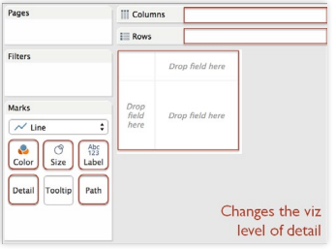
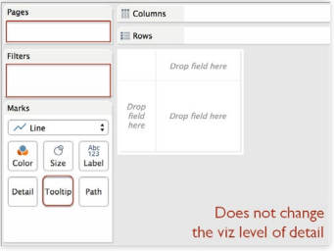
Notes:
A key aspect of exploring data is understanding the structure of the source. For example, you may have restaurant inspection data that at the most granular level is listed by its street address. You may then want to aggregate the data to view properties by zip code, city, state, or even country. In Tableau, you typically do this by dropping the dimensions you care about into your view (e.g., city, state). Depending on the dimensions you’ve chosen to add to the view, your data will be aggregated accordingly —to the “viz level of detail”, or Viz LOD for short

Slide 7
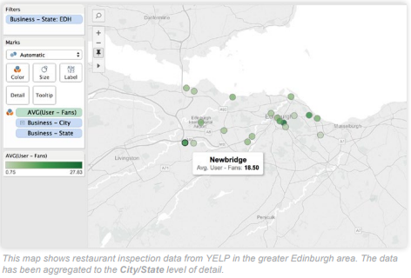
Notes:
Now here is a key point: LOD Expressions allow you to determine the levels of detail (i.e., the dimensions) used in a calculation without actually dropping those dimensions into the visualization. You can define the level of detail at which a calculation should be performed, independently of the Viz LOD. In the following example (using restaurant inspection data), two dimensions have been added to the view: City and State.

Slide 8
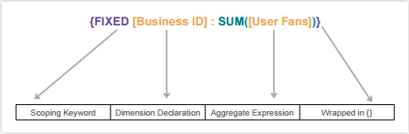
Notes:
The data in the view is aggregated based on the Viz LOD—which in this case consist of City and State— and is more aggregated than the underlying data source. The selected point in the image shows the average user fans for all restaurants in Newbridge, Edinburgh. Adding more granular dimensions to the view will result in a less aggregated Viz LOD. For instance, we could add Business ID to the visualization (by dropping it on the Detail Shelf), to see the average user fans for every individual business. Doing so will also change the visualization: every single business will appear as a circle on the map. But what if we don’t want the visualization to change? What if we want to determine the total user fans for each Business ID, average those values for each city, and show only one circle per city? What we want to see is the average number of fans per restaurant in each city. This will require adding an additional dimension to the view without dragging that dimension into the visualization. An LOD expression will allow us to this. Let’s create a new calculated field called Fans per Business. Here is a brief introduction to the syntax:
The expression tells Tableau to perform the aggregation for each Business ID, regardless of other dimensions used in the viz. You can use the LOD Expression to calculate the total User Fans per Business ID. After dragging this new field into the view, we can then average those values per city.

Slide 9
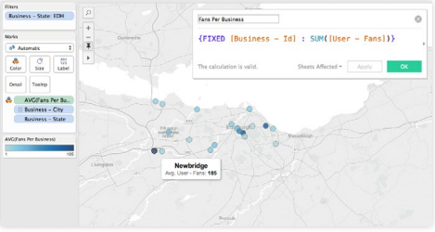
Notes:
By using the FIXED operator in our LOD Expression, we gain insight into which cities have, on average, more fans per Business ID. Meaning, those cities with a darker shade of blue have more popular restaurants (or the city could have more residents and hence, more total fans per restaurant). There are three types of LOD expression keywords—EXCLUDE, INCLUDE and FIXED—each of which alters the scope of the LOD expression.

Slide 10
Aggregate Bins

Slide 11
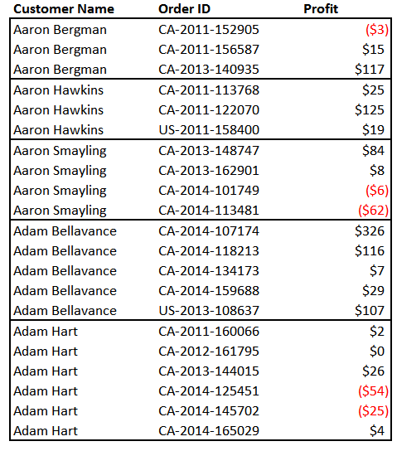
How many customers are profitable?

Slide 12
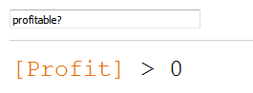

Slide 13
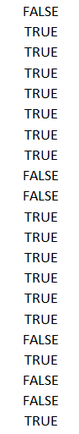

Slide 18
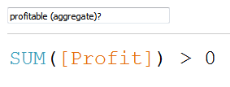
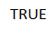

Slide 19
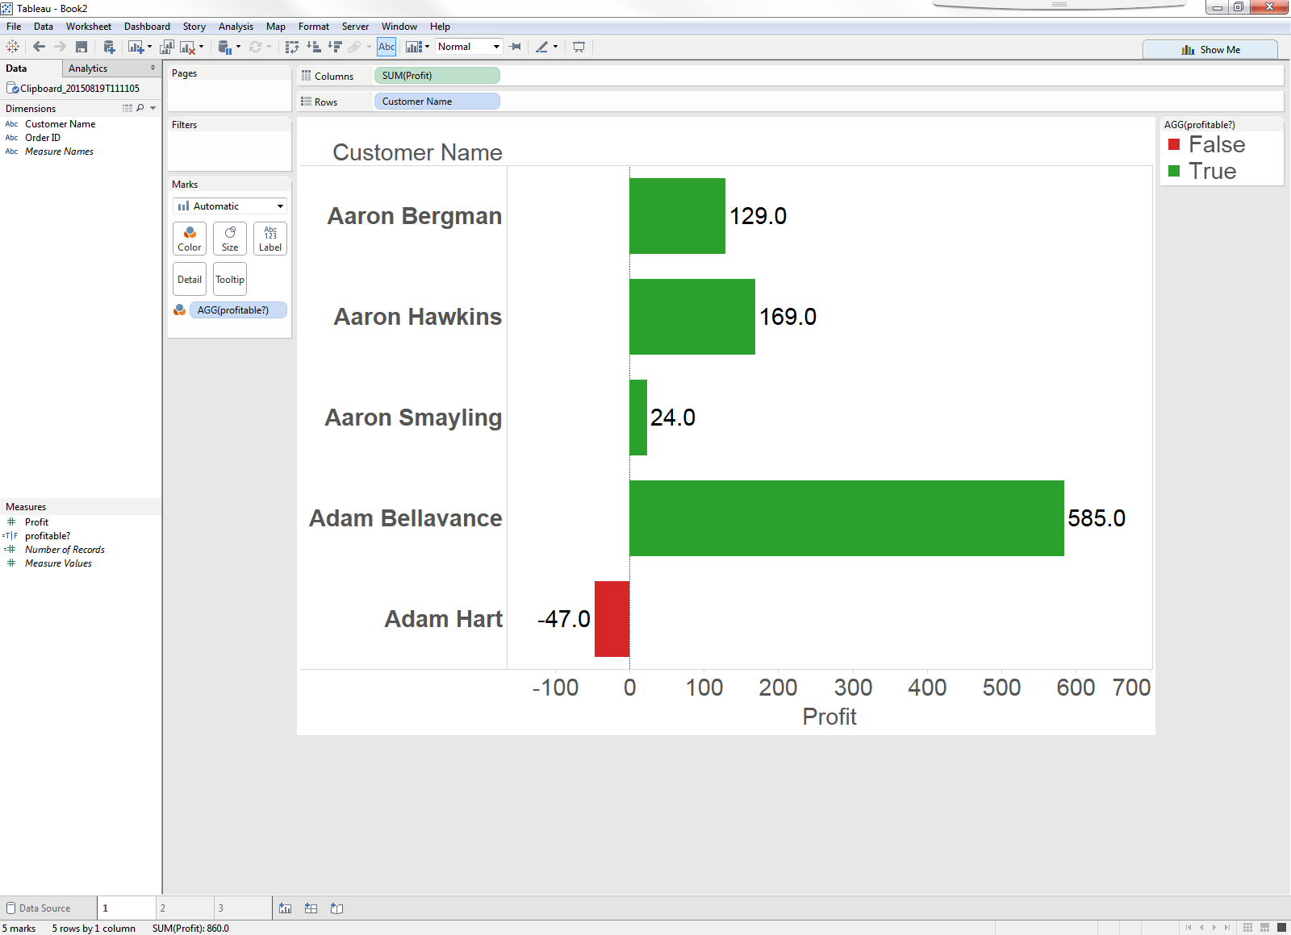

Slide 20
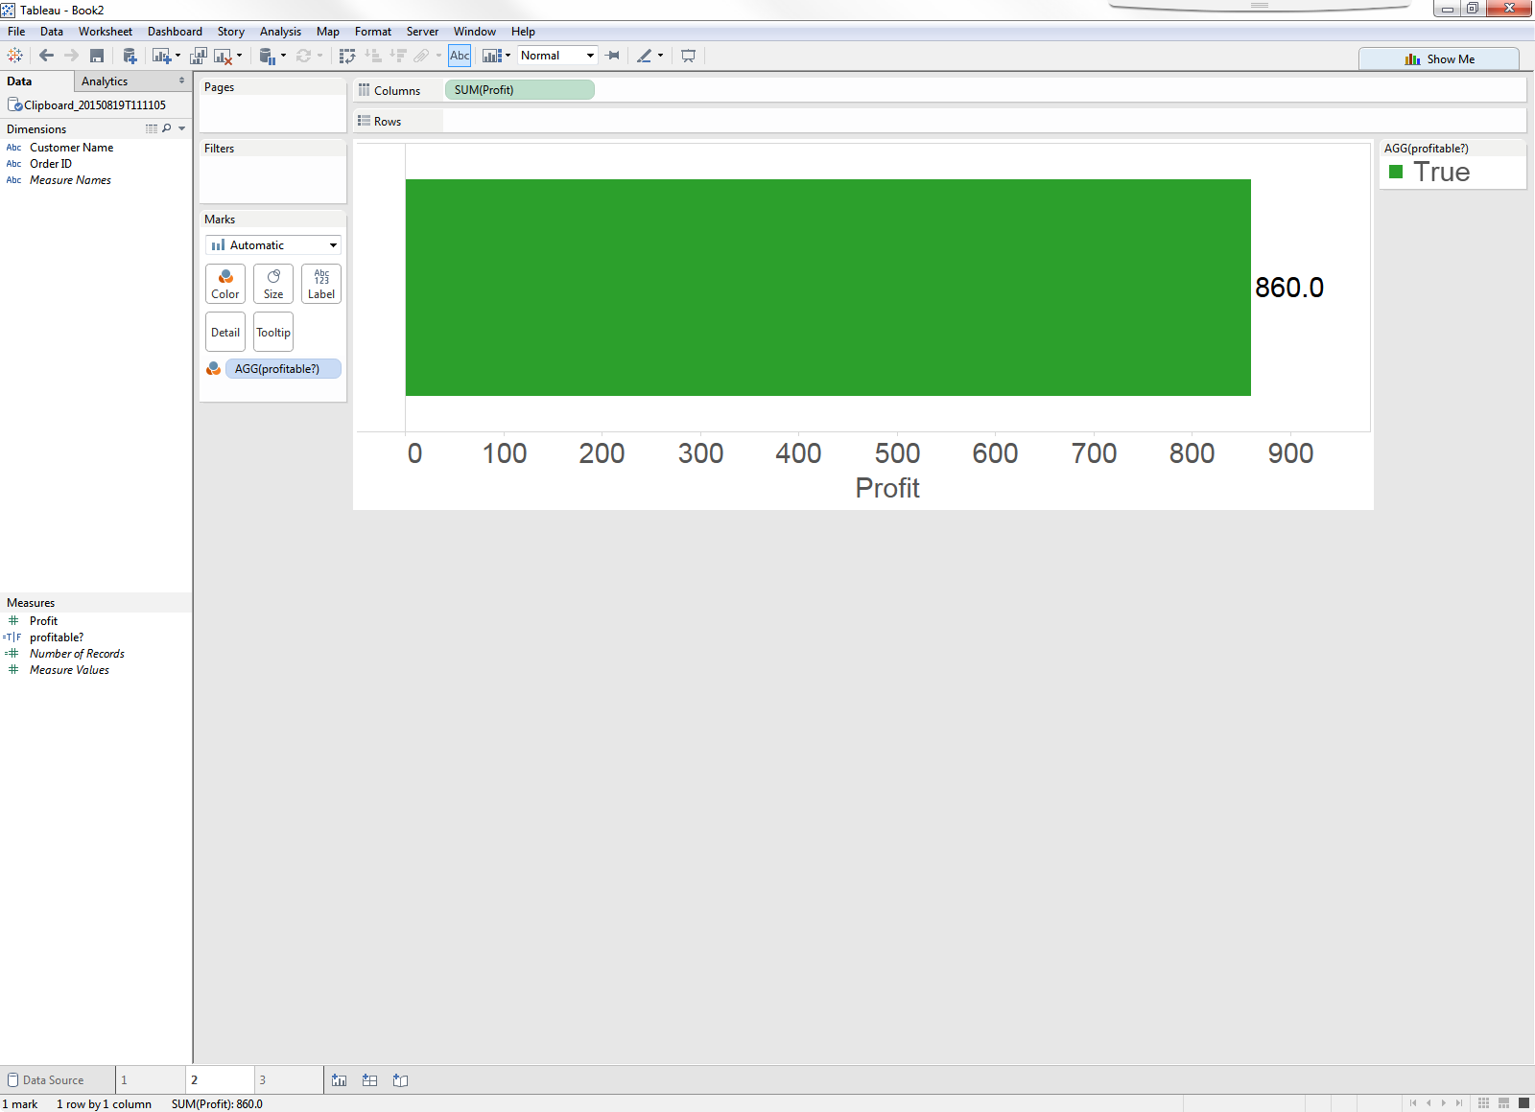

Slide 22
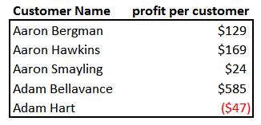

Slide 23
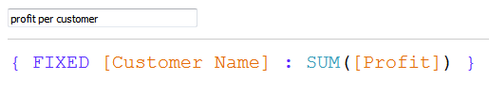

Slide 24
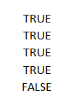

Slide 25
How many customers are profitable?

Slide 26
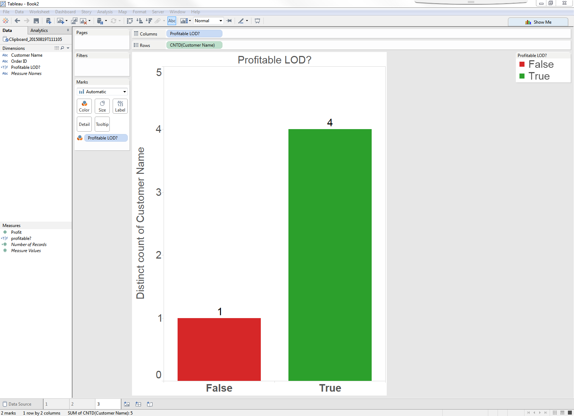

Slide 27
What is going on?

Slide 28


Slide 29
LODs are expressions, not calculations. This means we can reshape data on the fly.

Slide 30
No, really… what is going on?
Notes:
Tableau has had several mechanisms to calculate at a coarser level of detail than the sheet or perform multiple levels of aggregation for many releases. Reference lines, totals and table calculations have been commonly used methods for these tasks which worked very well in some cases but not others. What level of detail expressions bring to the table is the ability to use the results mixed with row level values, push the mixed and multi-level aggregate calculations to the database (as opposed to local calculations with other methods) and use results as dimensions, for table calculation addressing/partitioning, in actions or bin them.

Slide 31
{ keyword [dimension1],[dimension2]… : Aggregate expression }
Notes:
The portion highlighted in blue is the dimensionality expression which consists of 0 or more dimensions. If there is more than one dimension, they must be separated with commas. Aggregate expression does not necessarily have to be a simple aggregation e.g.SUM([Sales]) you can insert other calculations here, even wrap an IF block inside a level of detail expression.

Slide 32
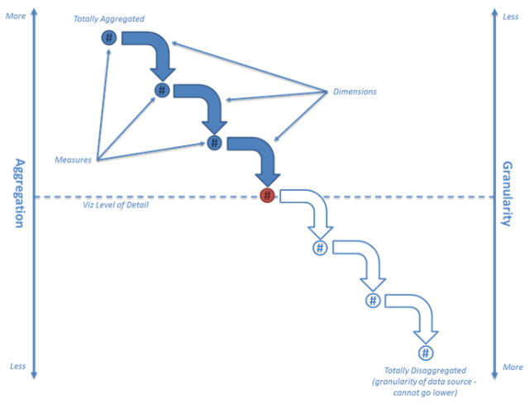
Viz in View

Slide 33
Today’s Lesson: Understanding LODs Exclude, Include, Fixed Case Studies using LODs Hands on Exercises Homework

Slide 34
3 Types of LODs: INCLUDE Less aggregated than view EXCLUDE More aggregated than view FIXED Specify the aggregation independently

Slide 35
3 Types of LODs: INCLUDE Less aggregated than view EXCLUDE More aggregated than view FIXED Specify the aggregation independently

Slide 36
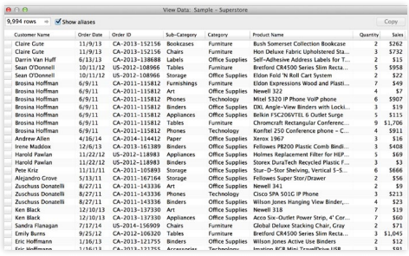
Notes:
The first row in this snapshot of the database is for a purchase of 2 Bush Somerset Bookcases. The second row is a purchase of 3 Hon Stacking Chairs. These two rows together comprise a single order—namely, order CA- 2013-152156. Suppose you are analyzing the sales performance of each region and would like to know which region has the highest (or lowest) average order size? 8 To figure this out, you need to calculate the size of each order (sum the sales corresponding to each Order ID), and then average those values by region. This business question is easy enough to ask…

Slide 37
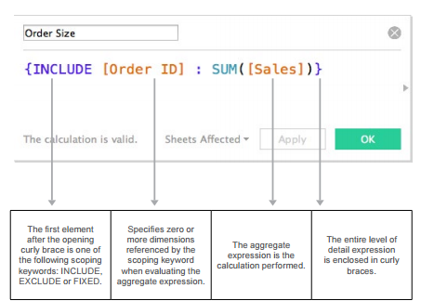

Slide 38
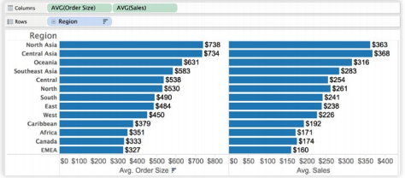
Notes:
You can see that North Asia and Central Asia have the highest average Order Size, $737 and $733 respectively. We were able to determine this even though Order ID does not appear in the visualization. (Before Tableau Version 9, we could not have computed these values unless Order ID had been added to the view). If we had simply plotted Region versus AVG(Sales)—as seen in the bars on the right in the figure— we would see the average of all line items (rows) in each Region, which is not the result we are looking for. In contrast, with the LOD expression Order Size, we are able to first determine the size of each order (i.e. the sum of sales for all line items within that order), and then average the resulting orders by Region to determine average Order Size by Region. Now that we have a sense of our largest average order size, let’s ask a slightly more complex question: Which country in the sales database has sales reps who close the “biggest deals,” on average? What we want to do is:

Slide 39
Which country in the sales database has sales reps who close the “biggest deals,” on average? What we want to do is: 1. Find the biggest deal (the max deal) that each sales person has ever closed, and then 2. Average those ‘biggest deals’ by country.

Slide 40
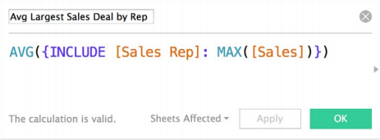
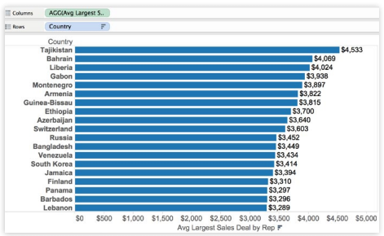

Slide 41
3 Types of LODs: INCLUDE Less aggregated than view EXCLUDE More aggregated than view FIXED Specify the aggregation independently

Slide 42
For each month, we want to see the total Sales, as well as the total sales by Region. To do this: 1. We need to exclude Region from our calculation of the monthly Total Sales 2. And then include Region when calculating the regional Sales breakdowns.

Slide 43
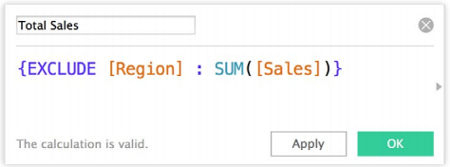
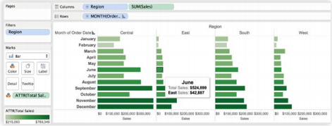
Notes:
Notice that in the viz above, Region has been placed on the Column shelf and thus contributes to the Viz LOD of Region, Month(Order Date). Using the EXCLUDE expression, you have the ability to calculate the total sales (across all regions) while displaying the regional sales breakdowns. As such, we have created an LOD expression that is “above” the Viz LOD (i.e. less granular):

Slide 44
3 Types of LODs: INCLUDE Less aggregated than view EXCLUDE More aggregated than view FIXED Specify the aggregation independently

Slide 45
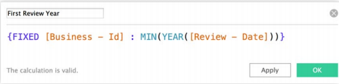
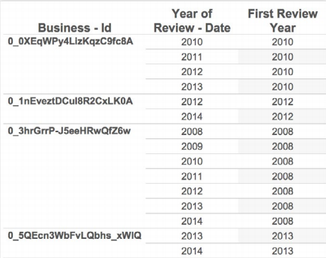
Notes:
LOD Expressions also open the door to creating an aggregation level completely independent of the Viz LOD; something that was previously only possible by using custom SQL. As an example, consider the following scenario: Let’s say you’d like to analyze YELP data to find the yearly cohorts in which a business had its first review. Does each cohort have the same review trends? With LOD Expressions, we can specify the cohort at an exact level of detail:
When we use this field in the viz, the calculation scope is implicitly defined in the expression. Once the First Review Year is recorded for each Business ID (as shown below), exploring the cohorts can be insightful.

Slide 46
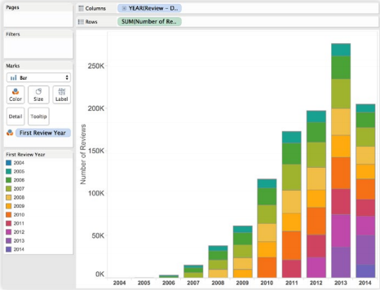

Slide 47
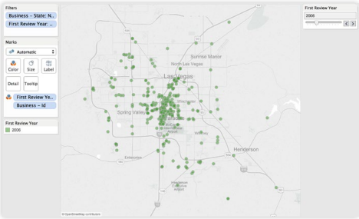
Notes:
Notice that each yearly cohort has been given a discrete “bin”—that is, First Review Year is used in the view as a dimension. FIXED expressions can be used as dimensions or measures. Depending on the data type, Tableau will place the resulting calculation either as a dimension or a measure.

Slide 48
The results of an LOD can be used as a DIMENSION or a MEASURE.

Slide 49
Viz in View

Slide 50
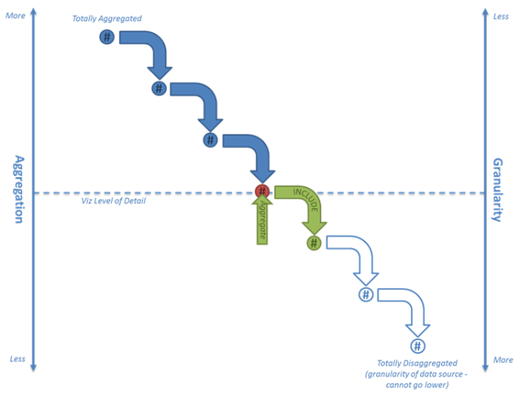
INCLUDE
Notes:
If you want to calculate an expression at a level that is (less aggregated than/more granular than/below) the Viz LOD, use the “INCLUDE” keyword. This adds the dimension(s) specified to the Viz LOD. As the result is (less aggregated/more granular) than the Viz LOD the value needs to be aggregated for each Viz LOD record (e.g. sum, avg, min, max, …).

Slide 51
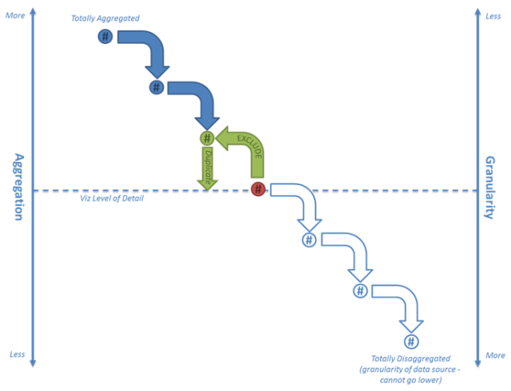
EXCLUDE
Notes:
A key to the EXCLUDE keyword: Tableau first removes the excluded dimension from the Viz LOD and performs the calculation as if the dimension was not present at all. The result is then displayed visually. A graphical representation of how Tableau performs an EXCLUDE LOD Expression is depicted in the following flow diagram.
If you want to calculate a result at a level (more aggregated than/less granular than/above) the Viz LOD, use the “EXCLUDE” keyword. This removes the dimension(s) specified from the Viz LOD. As the result is (more aggregated/less granular) than the Viz LOD the value needs to be duplicated for each Viz LOD record.

Slide 52
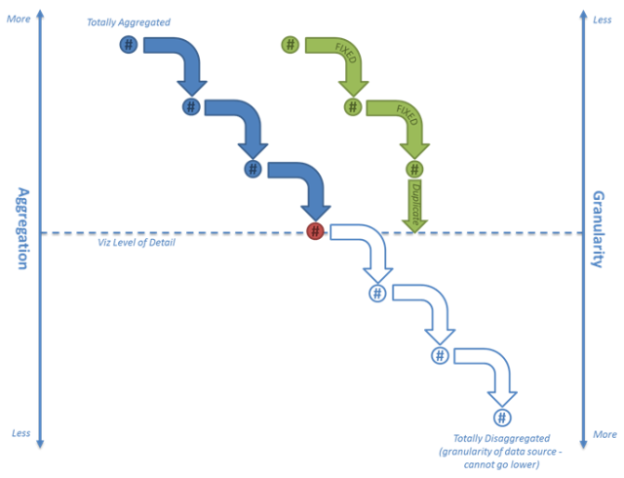
FIXED
Notes:
The “FIXED” keyword allows you to specify the aggregation/granularity independently to the dimensions used in the Viz LOD. If the result is (more aggregated than/less granular than) or unrelated to the Viz LOD then it is duplicated for each Viz LOD record.

Slide 53
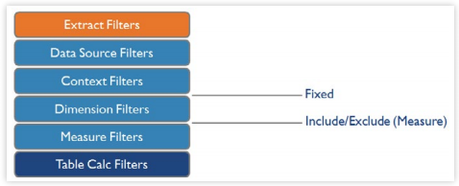

Slide 54
ERRRR, UHHHH, WHAT?!

Slide 55
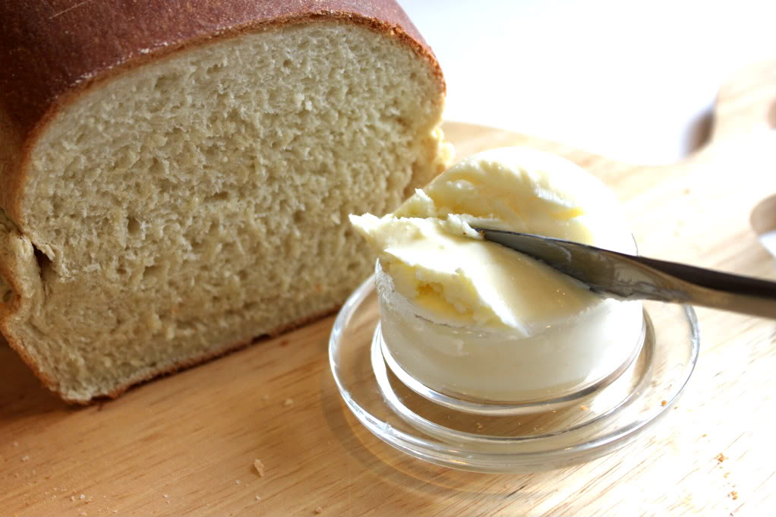
FIXED = YOUR BREAD & BUTTER

Slide 56
Today’s Lesson: Understanding LODs Exclude, Include, Fixed Case Studies using LODs Hands on Exercises Homework

Slide 57
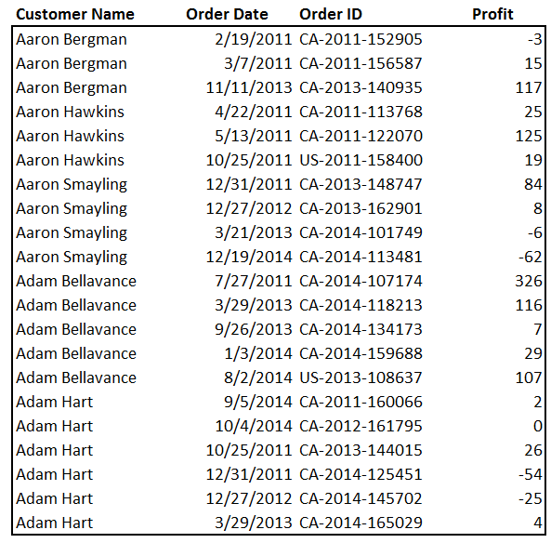
Always show the most recent date.

Slide 58
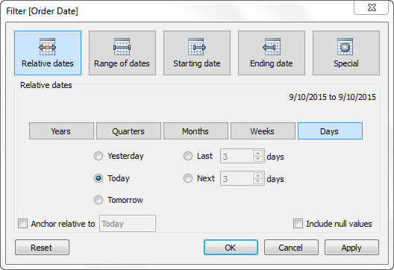

Slide 60
Does the Order Date = Max Order Date?

Slide 61
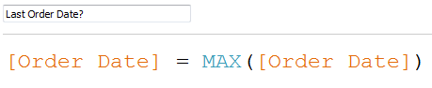
Does the Order Date = Max Order Date?

Slide 63
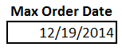

Slide 65
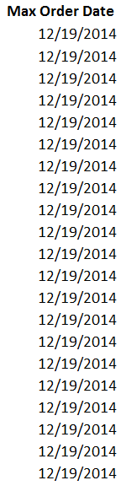

Slide 66
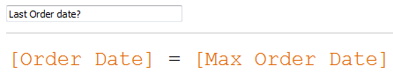

Slide 68
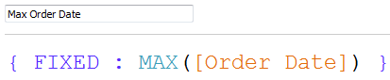

Slide 69
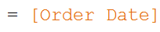

Slide 70
Filtering

Slide 71
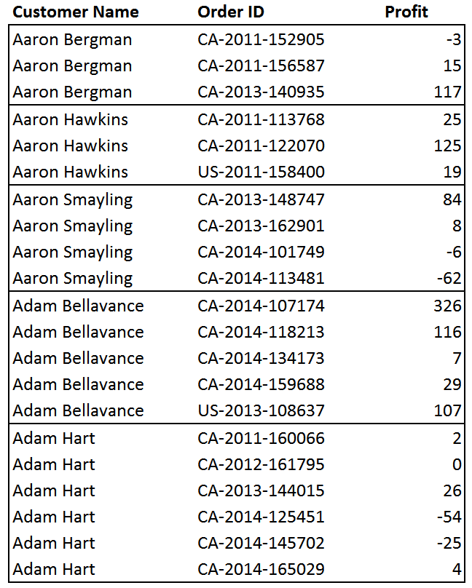
Filter to an individual customer and compare their average to the overall average

Slide 72
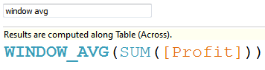

Slide 73
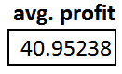

Slide 76
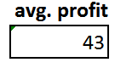

Slide 78
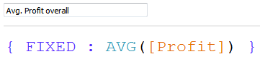

Slide 80
Nested LOD

Slide 81
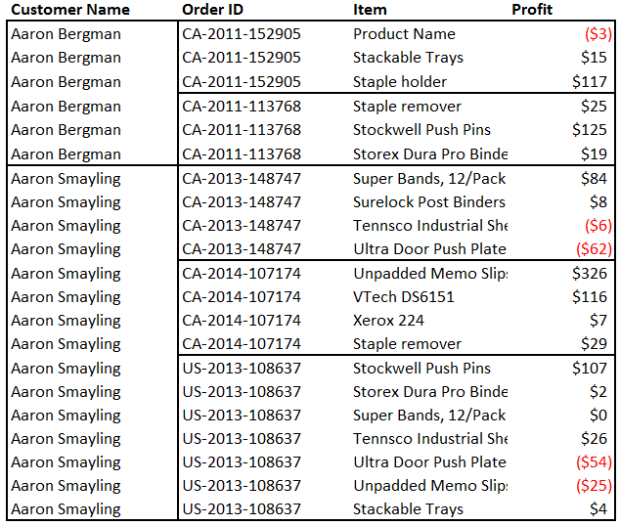
What is the average of our customers largest orders?

Slide 82
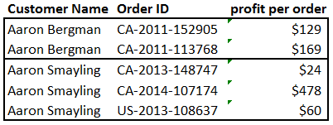

Slide 83
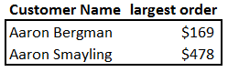

Slide 84
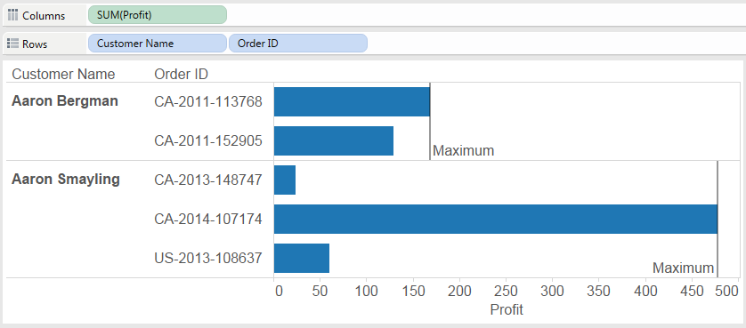

Slide 88
Reshaping Data

Slide 89


Slide 90


Slide 92


Slide 94


Slide 95



Slide 98


Slide 99
We learned: Aggregate Bins Dates Filtering Nested LOD Reshaping Data

Slide 100
Some limitations…. Results not materialized in extracts, sets/combined fields/parameters can’t be used within LOD, only field names used in dimensionality, table calcs can’t be used as aggregated measures, exclude/include can’t be used as dimensions, doesn’t work well with blending.
Notes:
Limitations
Calculations that involve level of detail expressions won’t be materialized in Tableau Extracts in 9.0.
Sets, combined-fields (use dimensions that make up the combined field individually by separating them with commas instead), parameters, table calculations cannot be used in the dimensionality expression in 9.0
Only field names can be used in dimensionality expression (e.g. an expression likeMAX([Order Date]) or YEAR([Order Date]) or an IF statement cannot be used in the dimensionality expression). Note that you can use a calculated field that has the formula YEAR([Order Date]) and use that instead. If you use {exclude [Order Date] :SUM([Sales])} and have [Order Date] in your sheet, Tableau will recognize the date hierarchy and automatically exclude the dateparts from calculation’s level of detail as you drill down.
Table calculations and ATTR are not allowed in aggregate expression e.g. {fixed[County] : ATTR([State])} or {fixed [County] : INDEX()} are not supported
Dimensionality from one source with measure from another blended source can not be mixed in a level of detail calculation
All dimensions in the dimensionality expression should come from the same data source
Level of detail expressions that use exclude or include keywords can not be used as dimensions. They also can not be binned. This is because they have relative dimensionality. While this may appear like an arbitrary limitation, it makes them much more understandable. Consider the case where there are two include calculations in the Sheet that are used as dimensions. Calculation1 is {include x : min(i)}, Calculation2 is {include y : min(k)}. If there are no other dimensions in the Sheet, Calculation1 will behave like {fixed x, Calculation2 : min(i)} and Calculation2 will behave like {fixed y, Calculation1 : min(k)}. Circular reference! This is a solvable problem but at the expense of understandability. We chose ease of use and simplicity instead.
Level of detail calculations from secondary sources can not be used via data blending 2 in 9.0
In 9.0 results from Level of detail calculations are cached as a whole (not broken down per sub-query) so generating same sub-queries in different sheets/calculations won’t result in cache hits.

Slide 101
Today’s Lesson: Understanding LODs Exclude, Include, Fixed Case Studies using LODs Hands on Exercises Homework

Slide 102


Slide 103


Clinton St & Washington Blvd
Larrabee St & Kingsbury St

Slide 104
Today’s Lesson: Understanding LODs Exclude, Include, Fixed Case Studies using LODs Hands on Exercises Homework

